Slide 1
Machine learning to unveil the fluid structure interaction of air-backed impact
Simon Carrillo Segura (PhD) | Akhilesh Kapse
11 June 2021

Slide 2
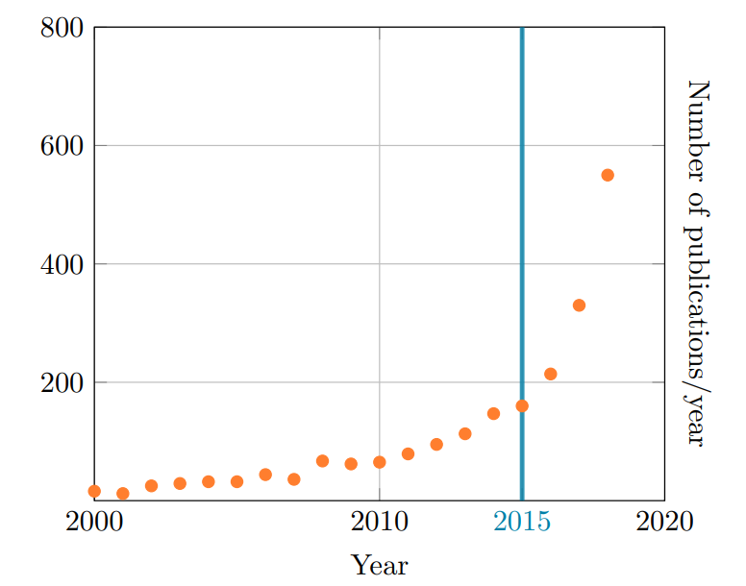
Introduction
Conservation laws have been the dominant building blocks for flow modeling over the past centuries.
Simulations using Navier–Stokes (RANS) equations are beyond our current computational resources for any general use. An alternative is to perform simulations based on approximations of these equations (Differential equations) or laboratory experiments for a specific configuration.
ML provides a modular and agile modeling framework that can be tailored to address many challenges in fluid mechanics, such as reduced-order modeling, experimental data processing, shape optimization, turbulence closure modeling, and control.
Number of publications matching keywords ”machine learning”, ”neural networks” and ”computational fluid dynamics” in Google Scholar, between 2000 and 2018. [Paper]
Developing Deep learning methods that can incorporate
physical laws in a systematic manner is a key element in
advancing AI for physical sciences.

Slide 3
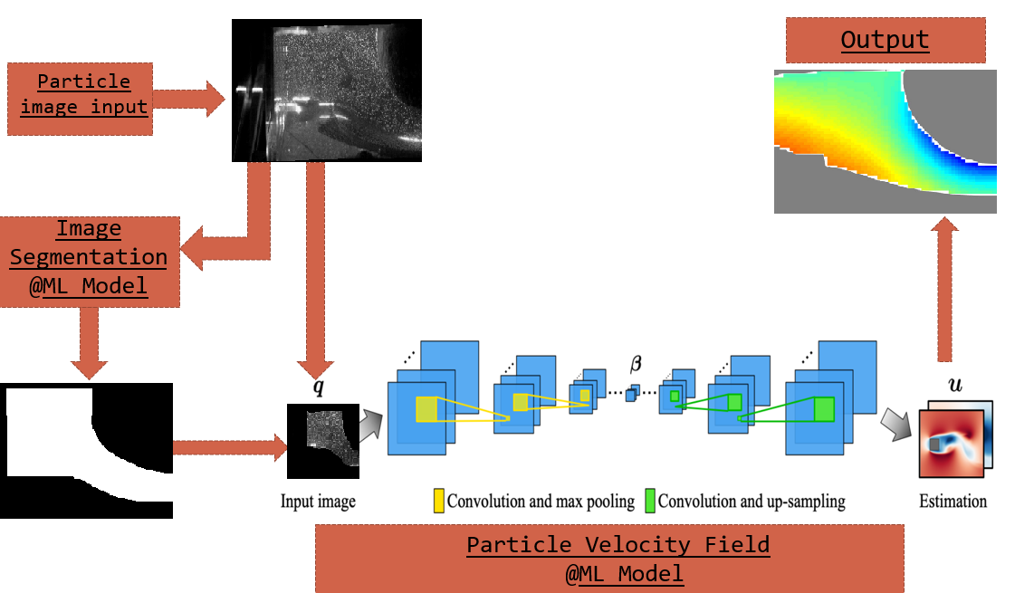
Pipeline

Slide 4
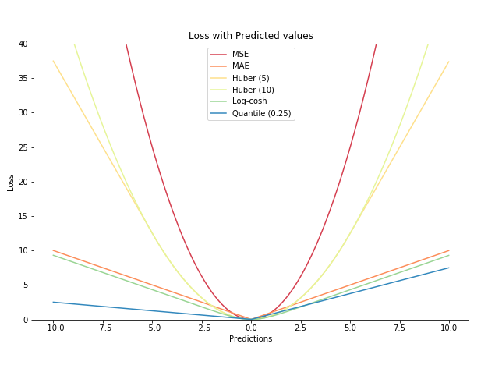
BaseLine-Model Architectures
and Losses
1. Classification (for Masking)-
● BCE Loss 1 for fluid and 0 for rest (wall, impactor, etc..)
2. Regression-
● Mean Square Error (L2 Loss)
● Mean Absolute Error (L1 Loss)
L1 loss is more robust to outliers, but its derivatives are not continuous, making it inefficient to find the solution. L2 loss is sensitive to outliers, but gives a more stable and closed form solution (by setting its derivative to 0.)
● Log-Cosh Loss
● Huber Loss (Smooth Mean Absolute Error)
● Average of absolute divergence over all pixels [Divergence=0 (conditional)]

Slide 5
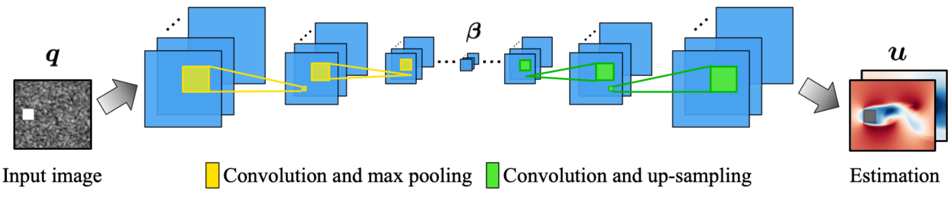
Ideas from Research Papers: U-Net
U-Net is more successful than conventional models, in terms of architecture and in terms pixel-based image segmentation formed from convolutional neural network layers.
Consists of a contracting path (left side) and an expansive path (right side).
At the end of the architecture, the output size is equal to the input size.
Ex.- Image Segmentation, Image Denoising, Dimensionality reduction, Clustering, etc.
https://arxiv.org/abs/1810.08217

Slide 6
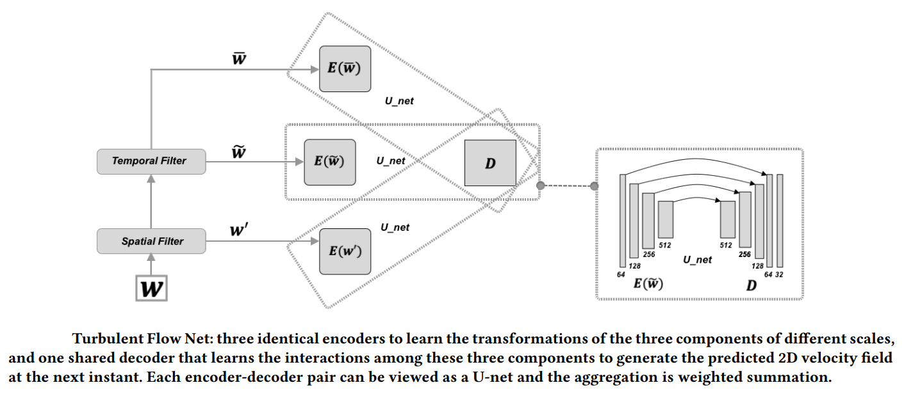
Ideas from Research Papers:
Turbulent Net
3-Identical encoders to learn the transformations of the three components of different scales.
One shared decoder that learns the interactions among these three components to generate the predicted 2D velocity field at the next instant.
Each encoder-decoder pair can be viewed as a U-net and the aggregation is weighted summation.
https://arxiv.org/abs/1911.08655

Slide 7
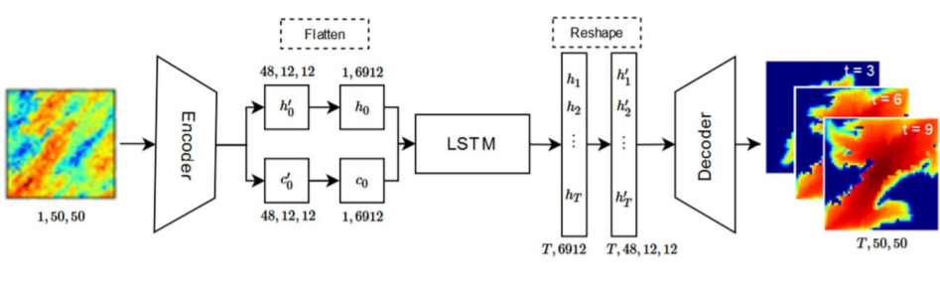
Ideas from Research Papers:
Dense ED-LSTM
Long Short-Term Memory (LSTM) networks are a type of recurrent neural network capable of learning order dependence in sequence prediction problems.
Breaking image embedding into multiple timesteps.
Passing the LSTM output back to decoder.
https://arxiv.org/abs/2006.05409

Slide 8
Thank You
Future work-
Experimental setup
Data pre-processing
MATLAB

